Slide 1




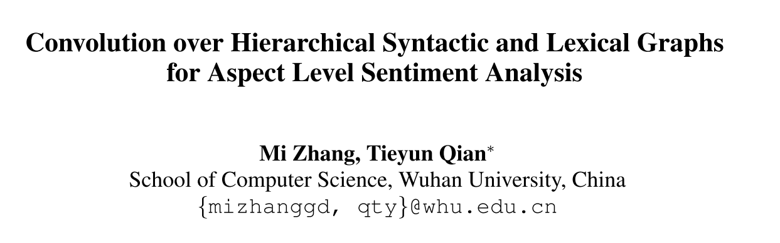





Chongqing University of Technology
ATAI
Advanced Technique of Artificial Intelligence
Chongqing University of Technology
EMNLP_2020
Hongyang Song

Slide 2
Outline
Motivation
Approach
Experiments
Conclusion

Slide 3
Motivation
food was okay, nothing special
I like hamburgers
The frequently co-occurred words represent the collocations in linguistics
Each type of syntactic dependency denotes a specific relation

Slide 4
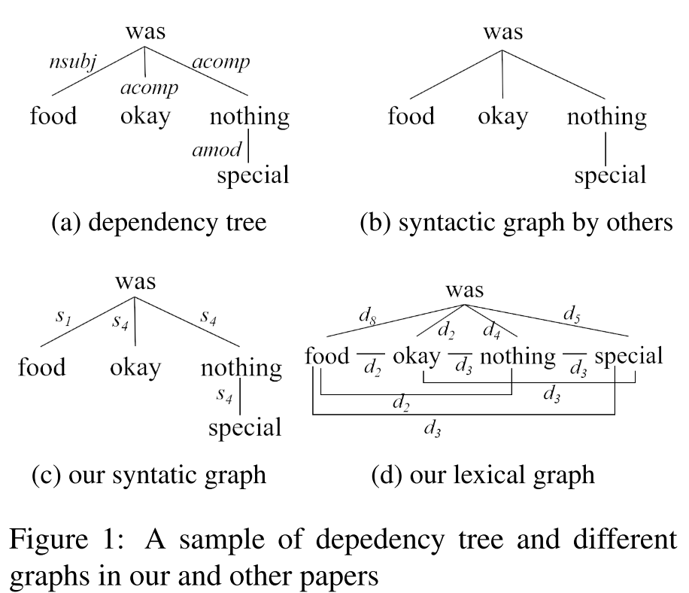
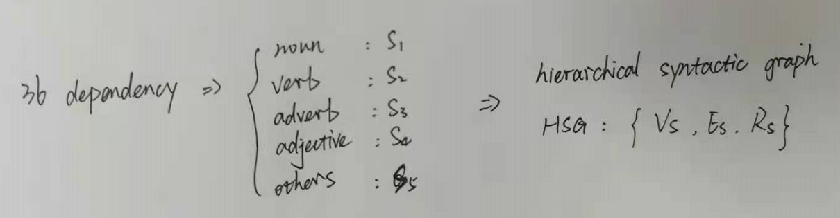
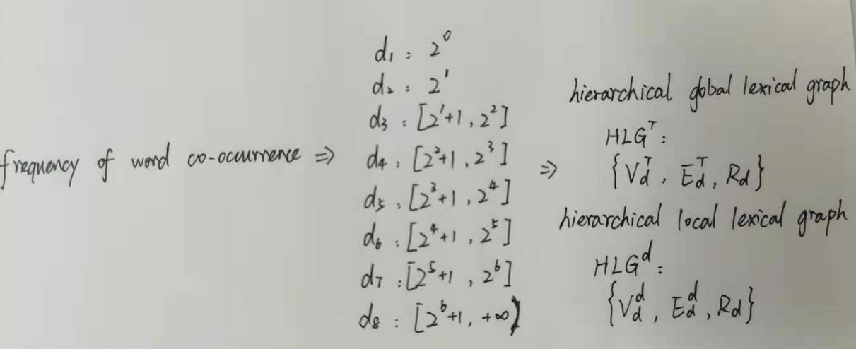
Approach

Slide 5
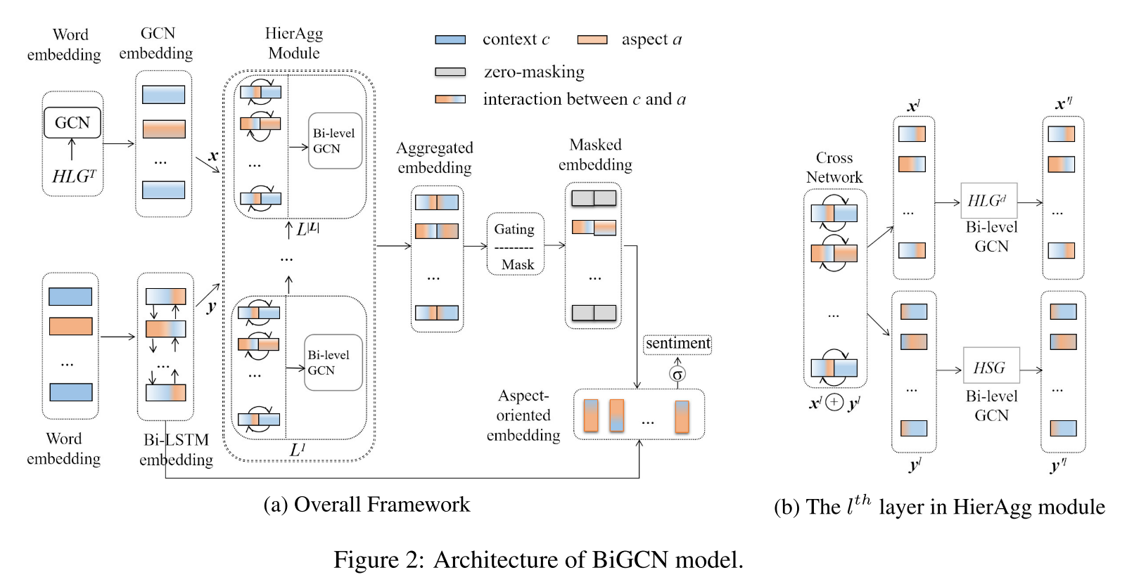
Approach

Slide 6




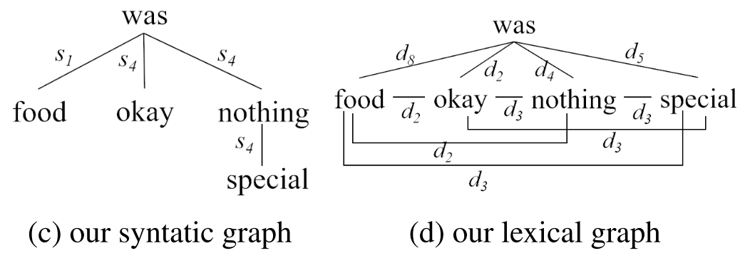



Approach
Notes:
BiGCN以全局词法图和单词序列作为输入，得到初始的句子表示。
提出了两种文本表示方法来改进句子嵌入。一个是基于全局词法图的GCN嵌入。另一种是基于双向LSTM的双LSTM嵌入。
uses the same normalized hidden feature sum
ICLR_2017_Semisupervised classification with graph convolutional networks

Slide 7
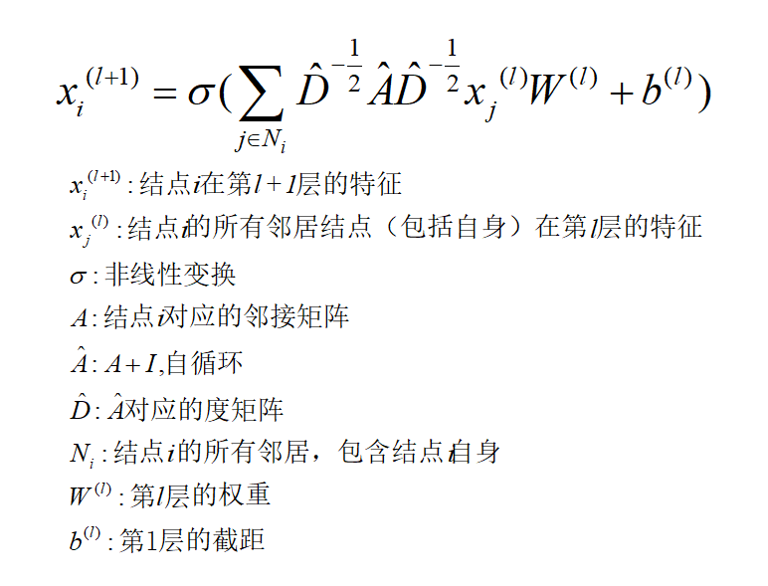
Approach
Notes:
BiGCN以全局词法图和单词序列作为输入，得到初始的句子表示。
提出了两种文本表示方法来改进句子嵌入。一个是基于全局词法图的GCN嵌入。另一种是基于双向LSTM的双LSTM嵌入。
ICLR_2017_Semisupervised classification with graph convolutional networks

Slide 8

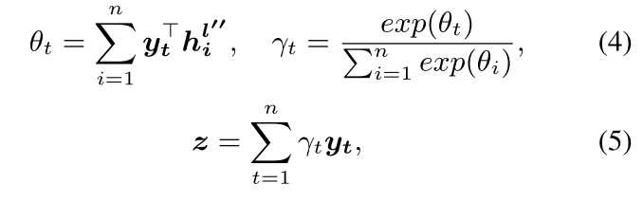

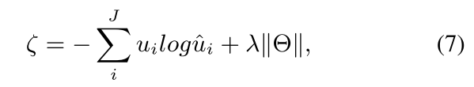
Approach
Notes:
ICLR_2017_Semisupervised classification with graph convolutional networks

Slide 9
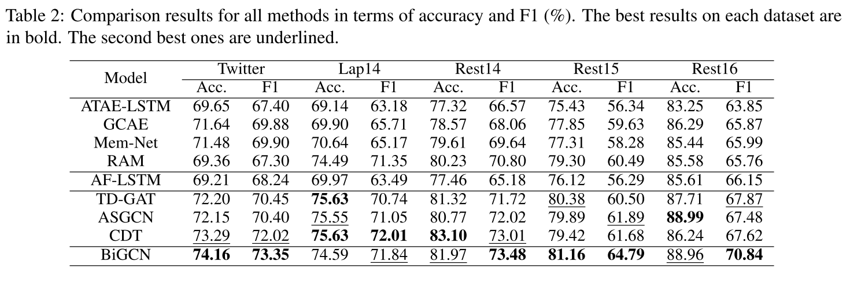
Experiments

Slide 10
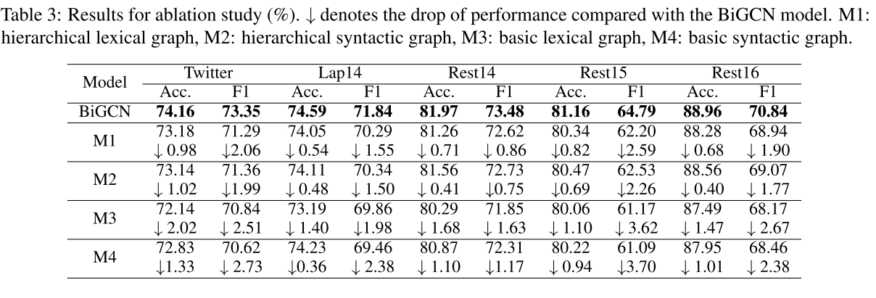
Experiments

Slide 11
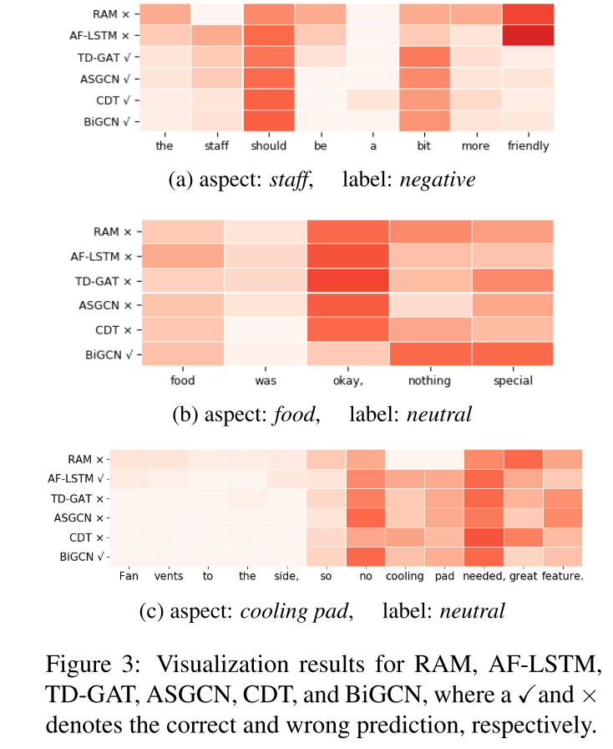
Experiments

Slide 12
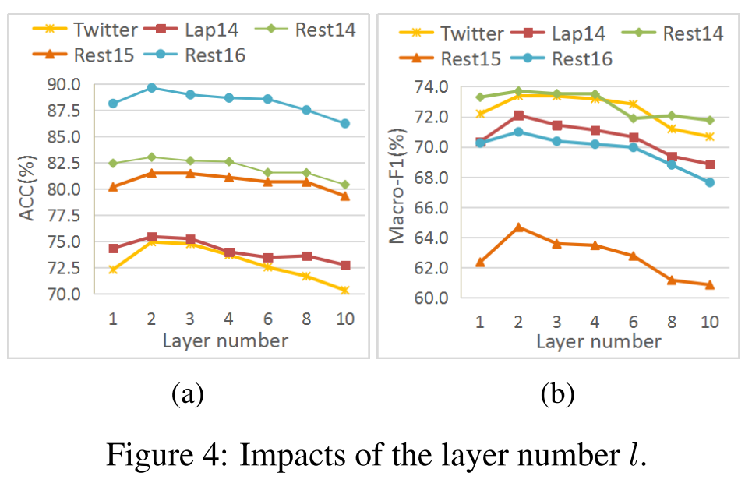
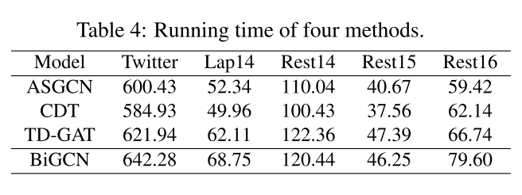
Experiments

Slide 13
Thanks

